Slide 1
What is an Industry Pathway?

Slide 2
What is an Industry Pathway?
An Industry Pathway gives students skill sets that assist them in entering the workforce or going onto further Apprenticeship or Traineeship pathways
The Industry Pathway Structures courses that assists students in obtaining entry level qualifications to local growth industries

Slide 3
Do I have to have an ATAR to go to University?
Each university has its own policies regarding school leavers without an ATAR.
Depending on the university, you may be able to gain entry with other qualifications.
Many universities have details on their website about their pathway into university without an ATAR. Many will consider students who undertake Certificate III or above qualifications.
If you think this pathway could be for you please indicate this on your SET Plan paperwork.
Please check the website of the university you are considering to see how to apply without an ATAR.
Students who wish to go to university through this pathway are recommended to undertake General English

Slide 4
General Subjects
General Subjects are suited to students who are interested in pathways beyond senior secondary schooling that lead to tertiary studies. General subjects are not recommended for Industry Pathway students.
Results in General subjects contribute to the awarded of a QCE and can contribute to an ATAR.
Students will need high level underpinning skills in literacy, numeracy and 21st century skills to be successful in these subjects.
Students must have undertaken pre-requisite subjects and achieved a pre-requisite grade in Year 10 to be able to enter general subjects in Years 11 and 12.

Slide 5
Essential and Applied Subjects
Applied subjects are suited to students who are primarily interested in pathways beyond senior secondary schooling that lead to vocational education and training or work.
Results in Applied subjects contribute to the award of a QCE and one Applied subject result may contribute to an ATAR.
At Lowood SHS we do not recommend students wishing to undertake an ATAR enter an Applied subject.
Students will need solid foundational skills in literacy, numeracy, applied learning, community connections and core skills for work from which to work in an Applied subject.

Slide 6
Nationally Recognised Qualifications - VET Subjects
Vocational education and training (VET) provides pathways for all young people, particularly those seeking further education and training, and those seeking employment-specific skills.
VET offers clear benefits to students including;
The development of work-related skills, making young people more employable
Access to learning opportunities beyond the traditional curriculum, including work-based learning
Competency-based assessment that meets industry standards

Slide 7
Why choose an Industry Pathway?
An Industry Pathway is suitable for students who plan on going straight from school into the workforce or into apprenticeships or traineeships
It is a pathway that allows students to gain their QCE and Nationally Recognised Qualifications
Allows students to undertake a School Based Apprenticeship or Traineeships
This pathway caters for all abilities and enables students to demonstrate their knowledge in more practical ways

Slide 8
Points to note
All subjects/qualifications are contingents on gaining enough students to run
Some certificates are subject to partnering with appropriate Registered Training Organisations if she certificate is not on Lowood SHS Scope of Registration
Many of the packages will require some financial contribution from the student/family

Slide 9
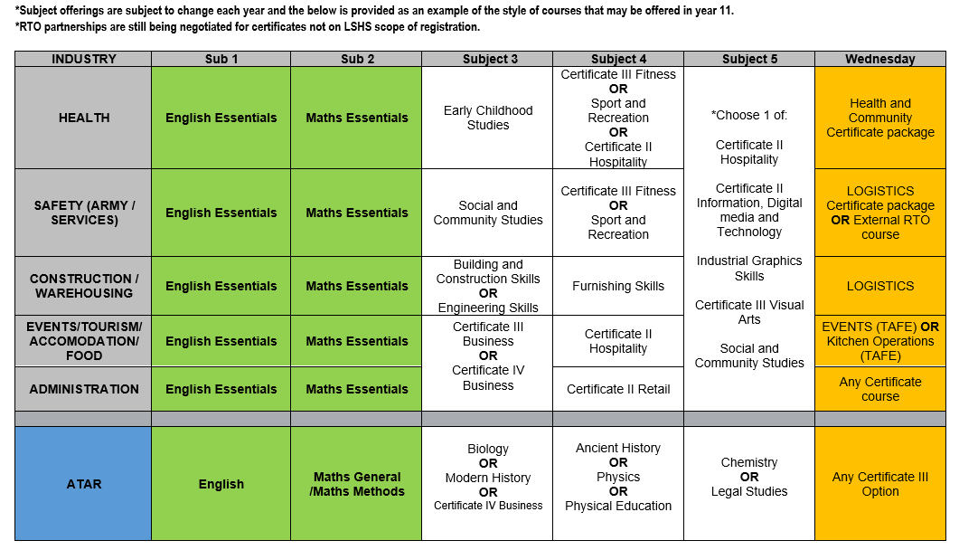
Year 11 Pathway Options 2023

Slide 10
Industry Pathway Courses (Notes)
Using a range of research Lowood has developed packages of suggested subjects.
The packages are aimed at giving students a rounded skill set that tells a story to a potential employer.
Although the packages are designed around an industry area this does not limit students ability to use the skills they gain in other industries after they leave school.

Slide 11
Prerequisite information
Prerequisites are courses of study and required academic achievement to enter specific senior subjects. These are set by the school taking into consideration the complexities and assumed knowledge that students require to be successful in the course.
This information is based on historical data of students undertaking courses of study and their success in those subjects.
If students are undertaking this pathway and plan on going to university it is recommended that they undertake General English.

Slide 12
Wednesday Program
With a growing number of students accessing TAFE and other outside provider courses, it was decided that Lowood would commit to providing opportunities to all students across Years 10, 11 and 12 in 2021 to participate in these courses.
We have sought partnerships and added qualifications to our scope of registration to provide a broad range of offerings on a Wednesday.
Wednesday qualifications run for one year only (unless otherwise specified).
Students are required to commit to these programs for the full year and no subject changes will be made after week 3 of term 1.

Slide 13
Wednesday Program for Industry students
 | Year 10 | Year 11 | Year 12
Recommended | Certificate II Qualification which includes Certificate II in Skills for work and Vocational Education Any other Cert II or Cert III by negotiation | Undertake the Certificate that links to/underpins your chosen industry pathway area. | Certificate II Qualification which includes Certificate II in Skills for work and Vocational Education Any other Cert II or Cert III by
Examples | Cert II Active Volunteering (+Skills for work) Cert II Financial Services (+Skills for work) Cert II DMT TAFE Automotive Engineering Salon Assistant | Cert II/III Health Cert II/III Logistics Cert II Kitchen Ops | Cert II Active Volunteering (+Skills for work) Cert II Financial Services (+Skills for work) Cert II DMT TAFE Automotive Engineering Salon Assistant

Slide 14
Contact Details
If you require any further details about Senior Schooling and the Pathways offered please feel free to contact:
Head of Department: Stacey Mallett
small17@eq.edu.au

Slide 15
Resources
QCAA – Queensland Certificate of Education (QCE), Planning your pathway
https://www.qcaa.qld.edu.au/downloads/senior/qce_planning_pathway_students.pdf

