Slide 1
Biology
General Subject

Slide 2
General Subjects
General Subjects are suited to students who are interested in pathways beyond senior secondary schooling that lead to tertiary studies.
Results in General subjects contribute to the awarded of a QCE and can contribute to an ATAR.
Students will need high level underpinning skills in literacy, numeracy and 21st century skills to be successful in these subjects.
Students must have undertaken Science Extension in year 10 and achieved a grade of B.

Slide 3
Frequently Asked Questions
Question: What prerequisites do need to choose Biology?
Answer: Students must have undertaken Science Extension in year 10 and achieved a grade of B.

Slide 4
Frequently Asked Questions
Question: What subject matter is covered in Biology?
Answer: Biology is broken up into 4 units. Units 1 and 2 are covered in year 11 and units 3 and 4 are covered in year 12
Cells and Multicellular Organisms
Maintaining the internal environment of organisms
Biodiversity and the interconnectedness of life
Heredity and the continuity of life

Slide 5
Frequently Asked Questions
Question: What assessment will I need to complete in Biology?
Answer: Like all senior sciences you will complete 4 assessment items in year 11 and 4 in year 12. You will complete a Data Test, Student Experiment, Research Task and an Exam that assesses a full year’s work. In year 12 the Exam is externally set and contributes 50% of your overall result.

Slide 6
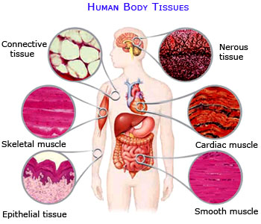
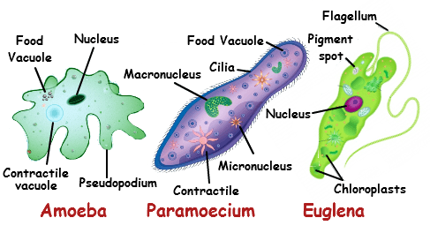
Cells and Multicellular organisms

Slide 7
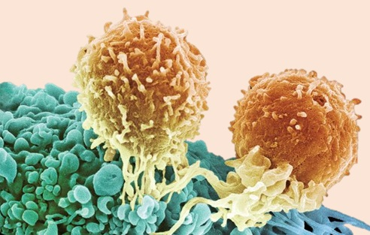
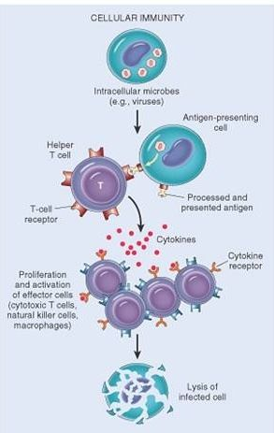
Maintaining the internal environment of organisms
Two T lymphocyte cells (orange) attack a cancer cell (blue), (credit: Science Source)

Slide 8
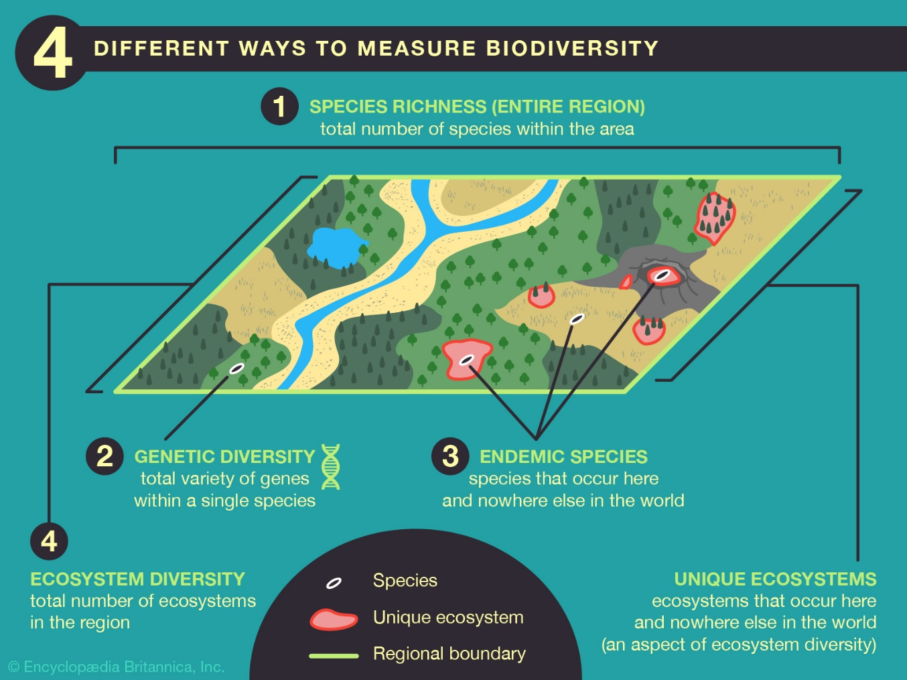
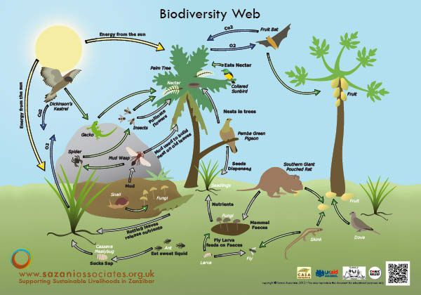
Biodiversity and the interconnectedness of life

Slide 9
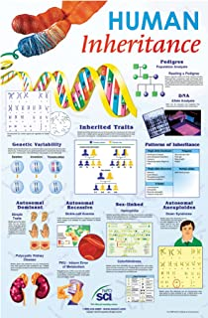
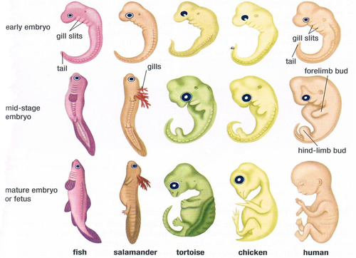
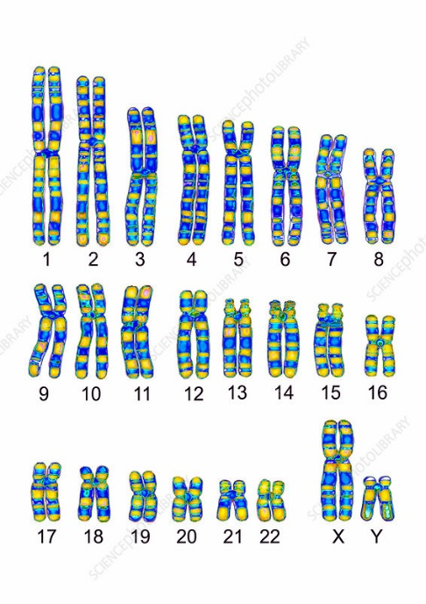
Heredity and the continuity of life

Slide 10
Contact Details
If you require any further details about this course please feel free to contact:
Subject area Teacher: Lisa Benjamin ljben1@eq.edu.au
Head of Department: Simon Bundy
sbund2@eq.edu.au

