Slide 1
Mathematical Methods
QCAA – General Subject
Contributes to an Australian Tertiary Admission Rank

Slide 2
General Subjects
General Subjects are suited to students who are interested in pathways beyond senior secondary schooling that lead to tertiary studies.
Results in General subjects contribute to the awarded of a QCE and can contribute to an ATAR.
Students will need high level underpinning skills in literacy, numeracy and 21st century skills to be successful in these subjects.
Students must have undertaken Advanced Maths Science, achieved a grade of a B to enter this subject.
Students should achieve a grade of A in Year 10 Mathematics.

Slide 3
Frequently Asked Questions
Question:
Why are there pre-requisites to enter this subject?
Answer:
Advanced Maths and Science (AMS) is a pre-requisite for Mathematical Methods as students need the additional concepts taught in AMS to be successful in their study of Mathematical Methods.
Mathematical Methods is a high level Mathematics Subject that requires a deep understanding of the mathematical concepts taught from Prep to 10 with a focus on algebra, linear and non-linear relationships. Students are also required to have highly developed problem-solving skills to be able to succeed in this academically demanding subject.

Slide 4
Frequently Asked Questions
Question:
Why should I choose Mathematical Methods over General Mathematics or Essential Mathematics?
Answer:
Mathematical Methods is designed for those students who are looking at studying Aeronautics, Engineering, Medicine, Sciences or similar courses at University. It is often a prerequisite for these courses.
Mathematical Methods can also be recommended for those who wish to become an electrician.

Slide 5
Frequently Asked Questions
Question:
What assessment will I have to complete?
Answer:
The ATAR contribution from Mathematical Methods is from Units 3 and 4. In units 3 and 4 you will complete 4 assessment Items:
IA1 – A Problem-solving and mathematical modelling task (4 weeks) based on Unit 3: 20% of your mark
IA2 – A 2 hour Internal Exam made up of two parts; 1 hour Tech Free (no calculator allowed), 1 hour Tech Active (scientific and graphics calculators allowed) based on Unit 3: 15% of your mark
IA3 – A 2 hour Internal Exam made up of two parts; 1 hour Tech Free (no calculator allowed), 1 hour Tech Active (scientific and graphics calculators allowed) based on Unit 4: 15% of your mark
EA4 – A 3 hour External Exam made up of two parts; 1½ hour Tech Free (no calculator allowed), 1½ hour Tech Active (scientific and graphics calculators allowed) based on Unit 3 and 4: 15% of your mark
Assessment for Units 1 and 2 will mirror that of Units 3 and 4

Slide 6
Frequently Asked Questions
Question:
What is a problem-solving and modelling task?
Answer:
A problem-solving and modelling task is a mathematical investigation where you:
Plan what you need to do on the given topic
Collect data/information
Perform calculations
Make a decision
Write a report on your findings that makes a justified recommendation.

Slide 7
Frequently Asked Questions
Question:
What topics are covered in Mathematical Methods?
Answer:
The major domains of mathematics in Mathematical Methods are Algebra, Functions, relations and their graphs, Calculus and Statistics. Topics are developed systematically, with increasing levels of sophistication, complexity and connection.
Calculus is essential for developing an understanding of the physical world. The domain Statistics is used to describe and analyse phenomena involving uncertainty and variation. Both are the basis for developing effective models of the world and solving complex and abstract mathematical problems.

Slide 8
Frequently Asked Questions
Question:
What resources do I have available to help me do my work?
Answer:
All senior students will be required to have their own laptops
as there is an online text book and resources. This year that has
been through Cambridge Go. Cambridge also offer other
resources such as answer guides and practice exam questions as
well as an online question and answer area.

Slide 9
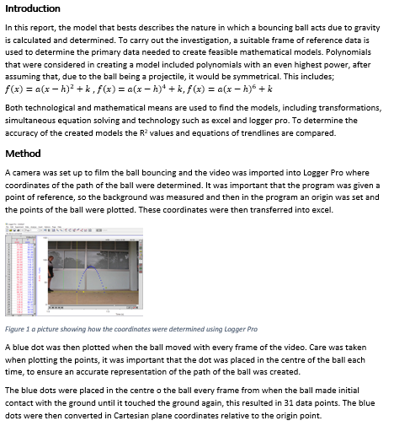
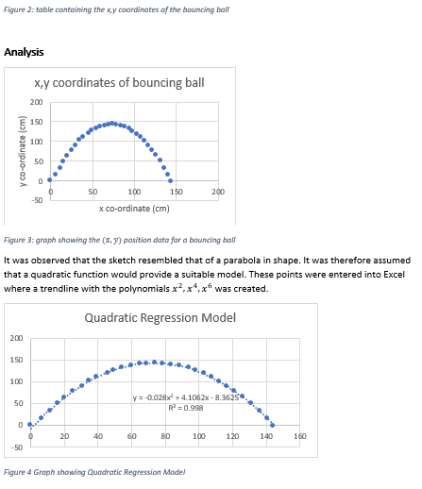
Student Work Samples

Slide 10
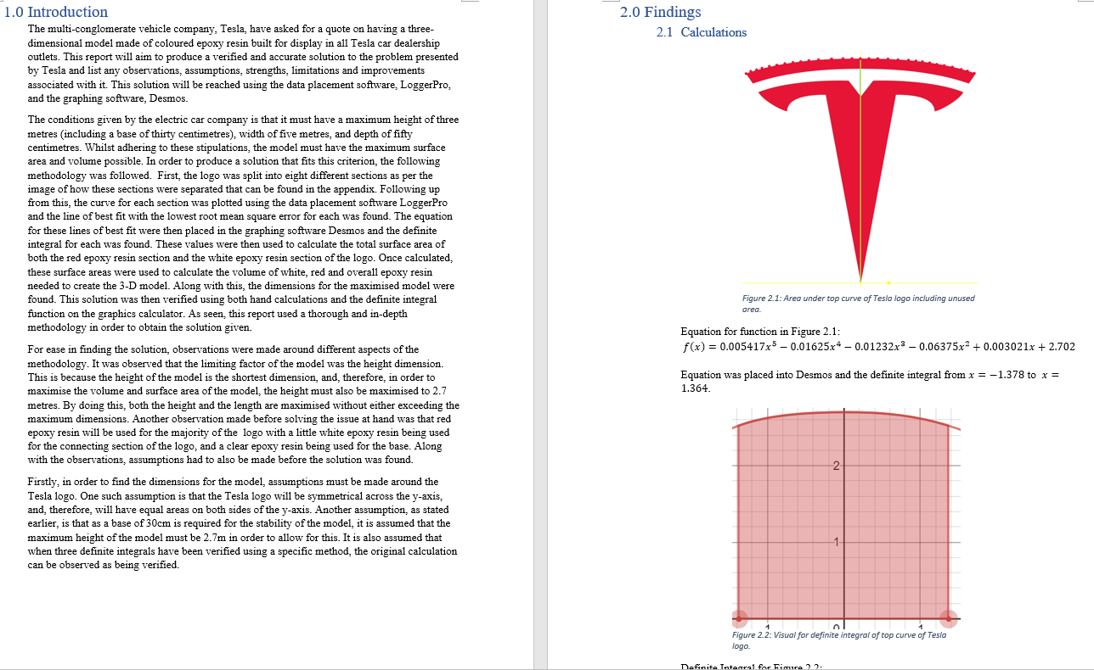
Student Work Samples

Slide 11
Student Work Samples

Slide 12
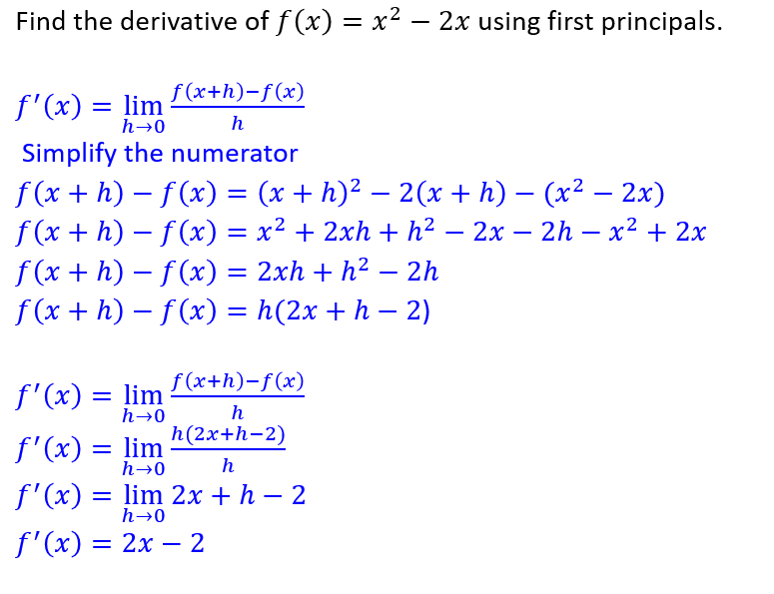
Student Work Samples

Slide 13
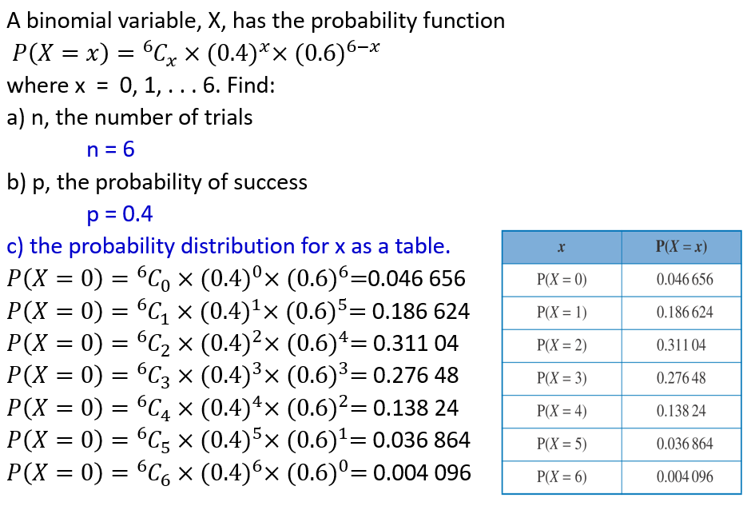
Student Work Samples

Slide 14
Contact Details
If you require any further details about this course please feel free to contact:
Subject Teacher: E-Jay Lindsay-Park
elind25@eq.edu.au
Head of Department: Gavin Lind
glind6@eq.edu.au

