Slide 1
Social and Community Studies
Applied Subject

Slide 2
Essential and Applied Subjects
Applied subjects are suited to students who are primarily interested in pathways beyond senior secondary schooling that lead to vocational education and training or work.
Results in Applied subjects contribute to the award of a QCE and one Applied subject result may contribute to an ATAR.
At Lowood SHS we do not recommend students wishing to undertake an ATAR enter an Applied subject.
Students will need solid foundational skills in literacy, numeracy, applied learning, community connections and core skills for work from which to work in an Applied subject.

Slide 3
Frequently Asked Questions
Question:
What topics will we cover in SCS?
Answer:
Over the two year course, topics will include:
Gender and Identity
Health and Nutrition
Australia’s place in the World
Science and technology and how they affect your life
The world of work
Legally, it could be you – the role of law in our everyday lives.

Slide 4
Frequently Asked Questions
Question:
What assessment will I have to complete?
Answer:
There are 4 types of assessment in SCS. You will complete all 4 types in Year 11, and the all 4 types again in Year 12. There is NO EXTERNAL EXAM.
Examination - Combination Response
Project – written, practical and reflective components
Investigation – multimodal presentation
Examination – Essay response

Slide 5
Frequently Asked Questions
Question:
What sort of projects do we do?
Answer:
A project has written and practical components. For example, a project to hold an information market day for healthy lifestyles will involve some planning, some research, designing handouts, thinking about what to say to people visiting your market stall, creating fun activities for the day and finally, reflecting on your market stall and critically evaluating your performance.

Slide 6
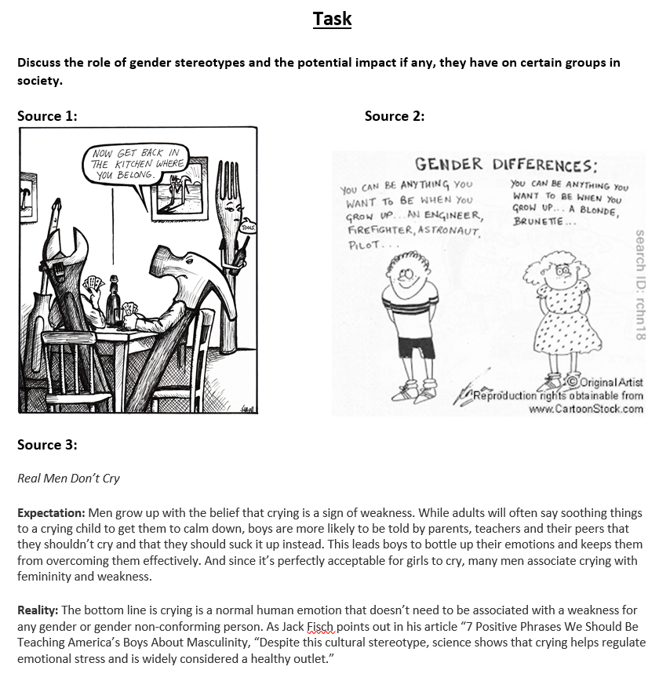
Student Work Samples
Responding to sources

Slide 7
Student Work Samples
Multimodal Investigation

Slide 8
Contact Details
If you require any further details about this course please feel free to contact:
Subject area Teachers: Laura McKay lxmck6@eq.edu.au
Chris McCall
cdmcc0@eq.edu.au
Emma Hansen
eahan0@eq.edu.au
Head of Department: Chris McCall
cdmcc0@eq.edu.au

